Slide 1
AIR POLLUTION MONITORING SYSTEM USING IoT

Slide 2
CONTENT
ABSTRACT
INTRODUCTION
PROBLEM STATEMENT
OBJECTIVE
LITERATURE REVIEW
RESEARCH METHODOLOGY
SYSTEM REQUIREMENT
ADVANTAGES & APPLICATIONS
EXPERIMENTAL SETUP & RESULT
CONCLUSION & FUTURE SCOPE
REFERENCES

Slide 3
ABSTRACT
This project presents the design and implementation of an IoT-based Air Pollution Monitoring System that provides real-time detection and analysis of harmful gases in the environment.
Utilizing the MQ135 gas sensor and NodeMCU microcontroller, the system measures concentrations of pollutants such as CO2, NH3, and Benzene.
The collected data is transmitted via Wi-Fi to the ThingSpeak cloud platform, where it is displayed in numerical and graphical formats.
The system evaluates air quality based on predefined thresholds and categorizes it as good, moderate, or bad.
In the case of poor air quality, a buzzer is triggered to alert nearby users.

Slide 4
INTRODUCTION
The rising pollution levels have directly impacted human health, leading to respiratory issues, cardiovascular diseases, and even premature deaths in heavily polluted areas.
The importance of monitoring and controlling air quality has become critical, and understanding its impact on public health is more vital than ever.
This project proposes an Air Pollution Monitoring System using IoT that integrates cutting-edge technology to provide real-time data on air quality.
The system categorizes air quality into various levels (good, moderate, or bad) and triggers an immediate alert when pollution levels exceed safe thresholds.
This automated, scalable, and cost-effective system enables timely intervention and prove essential air quality information to users.

Slide 5
PROBLEM STATEMENT
Air pollution has become a critical issue due to the rapid growth of industries, increasing vehicle emissions, deforestation, and urbanization.
The air we breathe is increasingly contaminated with toxic gases.
Prolonged exposure to polluted air leads to severe health issues including asthma, respiratory infections, cardiovascular diseases, and in extreme cases, premature death.
Children, the elderly, and individuals with pre-existing conditions are especially vulnerable.
Despite its dangers, many people remain unaware of the quality of the air around them due to a lack of accessible and real-time monitoring systems.
This highlights the urgent need for a simple, low-cost, and efficient air pollution monitoring system.

Slide 6

OBJECTIVE
1. To monitor and detect harmful gases in the environment using sensors.
2. To evaluate air quality status based on standard threshold values.
3. To alert users through a buzzer when air pollution reaches unsafe levels.

Slide 7
LITERATURE REVIEW
Sr. No. | Author | Title | Journal | Findings
1. | Parmar, Gagan, et. al, | "An IoT based low cost air pollution monitoring system." | In 2020 International Conference on Recent Innovations in Signal processing and Embedded Systems (RISE), pp. 524-528. IEEE, 2020. | They developed a prototype for an Environmental Air Pollution Monitoring System for monitoring the concentrations of major air pollutant gases.

Slide 8
2. | Malleswari,et. al, | "Air pollution monitoring system using IoT devices." | Materials Today: Proceedings 51 (2022): 1147-1150. | Their purpose is to understand Information on environmental variables and also allowing easy integration into any other type of internet-based architecture (IoT).
3. | Pal, Poonam, et.al, | "IoT based air pollution monitoring system using Arduino." | International Research Journal of Engineering and Technology (IRJET) 4, no. 10 (2023): 1137-1140. | They are going to make an IOT Based Air Pollution Monitoring System in which we will monitor the Air Quality over a web server using internet and will trigger a alarm when the air quality goes down beyond a certain level.

Slide 9
4. | Dhingra, Swati, et. al, | "Internet of Things mobile–air pollution monitoring system (IoT-Mobair)." | IEEE Internet of Things Journal 6, no. 3 (2019): 5577-5584. | They proposes a three-phase air pollution monitoring system. An IoT kit was prepared using gas sensors, Arduino integrated development environment (IDE), and a Wi-Fi module.
5. | Xiaojun, Chen, et.al, | "IOT-based air pollution monitoring and forecasting system." | In 2023 international conference on computer and computational sciences (ICCCS), pp. 257-260. IEEE, 2023. | They presented a a kind of real-time air pollution monitoring and forecasting system which can reduce the hardware cost by 1/10 as before.

Slide 10
RESEARCH METHODOLOGY
The NodeMCU collects gas concentration data and processes it into meaningful units like PPM or percentage.
Using its built-in Wi-Fi, the NodeMCU sends this data to the ThingSpeak IoT platform, where it is displayed in real-time and plotted as graphs for each gas.
The system then evaluates the air quality based on predefined thresholds, categorizing it as good, moderate, or bad.
If the air quality is determined to be bad, a buzzer is triggered to alert nearby users immediately.

Slide 11
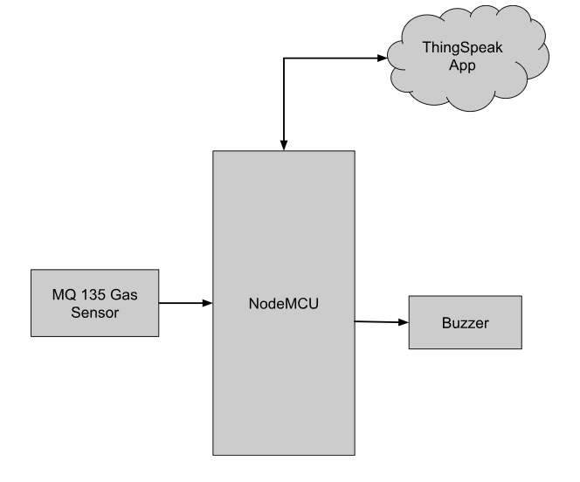
BLOCK DIAGRAM
DESCRIPTION
In this block diagram, we have used a Node MCU as a microcontroller. We have used an MQ 135 Gas Sensor as an input device and as an output device we have used a Buzzer connected to the microcontroller. And we have used the ThingSpeak app to show all the notifications.

Slide 12
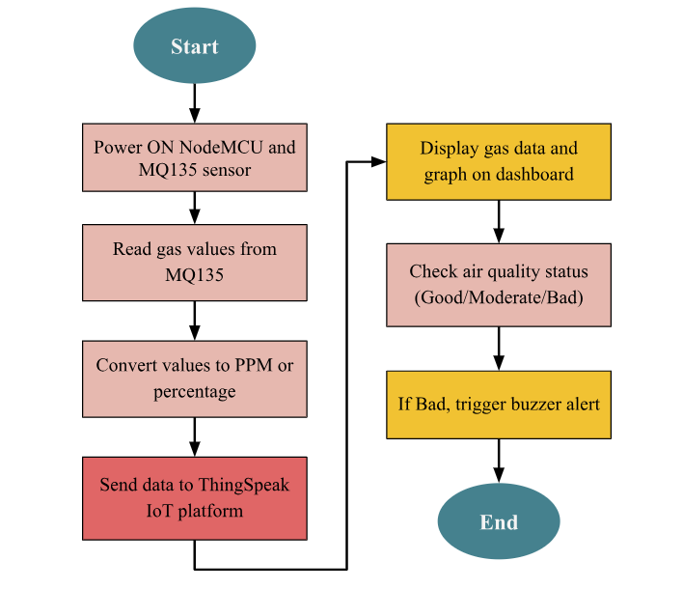
FLOW CHART

Slide 13
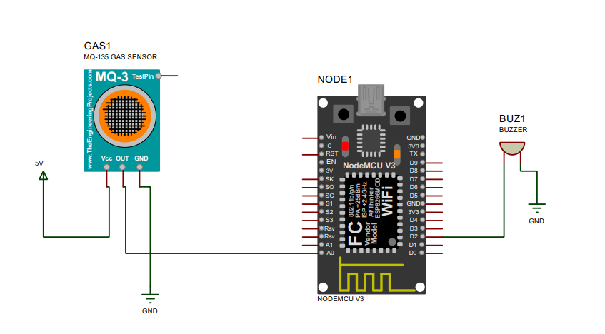
CIRCUIT DIAGRAM

Slide 14
WORKING
The Air Pollution Monitoring System operates by first collecting air quality data through the MQ135 sensor, which detects the presence of harmful gases.
This data is sent to the NodeMCU, which processes the readings and converts them into standard units.
The NodeMCU then transmits the data to the ThingSpeak IoT platform over Wi-Fi, where it is displayed on a dashboard and visualized through real-time graphs.
The system compares the gas levels against set thresholds to determine the current air quality status.
If the air quality is found to be poor, the NodeMCU immediately triggers a buzzer to alert nearby individuals.

Slide 15
SYSTEM REQUIREMENT
HARDWARE REQUIREMENT
NodeMCU
MQ135 Sensor
Buzzer
SOFTWARE REQUIREMENT
1. Arduino IDE
2. Proteus

Slide 16
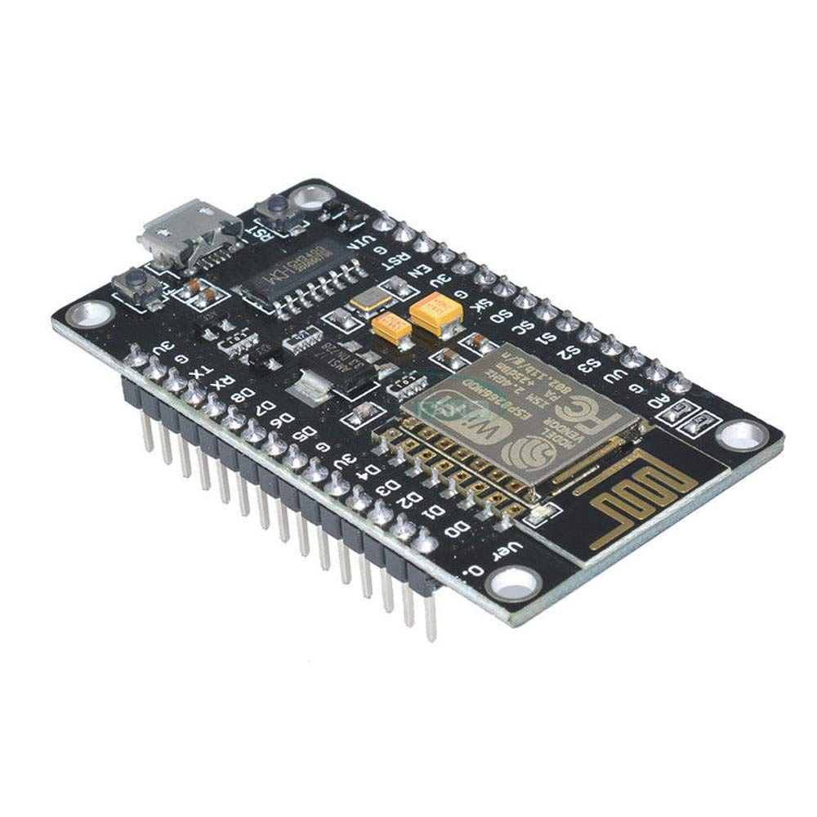
NODEMCU - ESP8266 WIFI DEVELOPMENT BOARD
The NodeMCU (Node MicroController Unit) is an open source software and hardware development environment that is built around a very inexpensive System-on-a-Chip (SoC) called the ESP8266.
It has also WiFi capabilities, so we can control it wirelessly.
To do so we can use the the Arduino Software (IDE).
The ESP8266, designed and manufactured by Espressif Systems, contains all crucial elements of the modern computer: CPU, RAM, networking (wifi), and even a modern operating system and SDK.

Slide 17
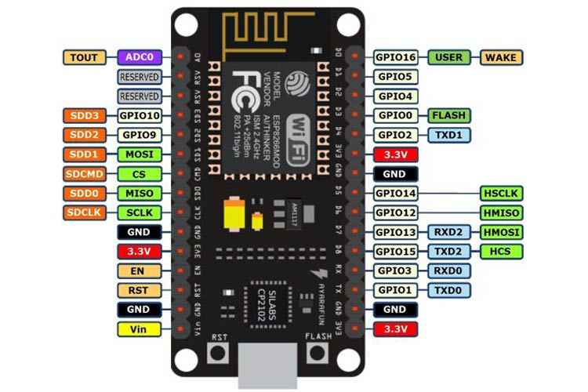
NODEMCU PINOUT DIAGRAM

Slide 18
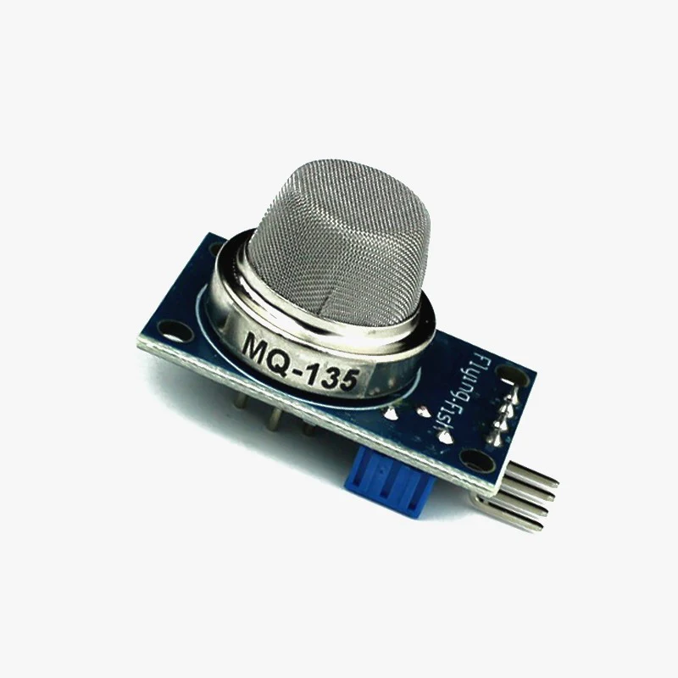
MQ-135 (AIR QUALITY SENSOR)
The MQ135 is one of the popular gas sensors from the MQ series of sensors that are commonly used in air quality control equipment.
It operates from 2.5V to 5.0V and can provide both digital and analog output.
The MQ-135 Gas sensor can detect gases like Ammonia (NH3), sulfur (S), Benzene (C6H6), CO2, and other harmful gases and smoke.
Similar to other MQ series gas sensor, this sensor also has a digital and analog output pin.

Slide 19
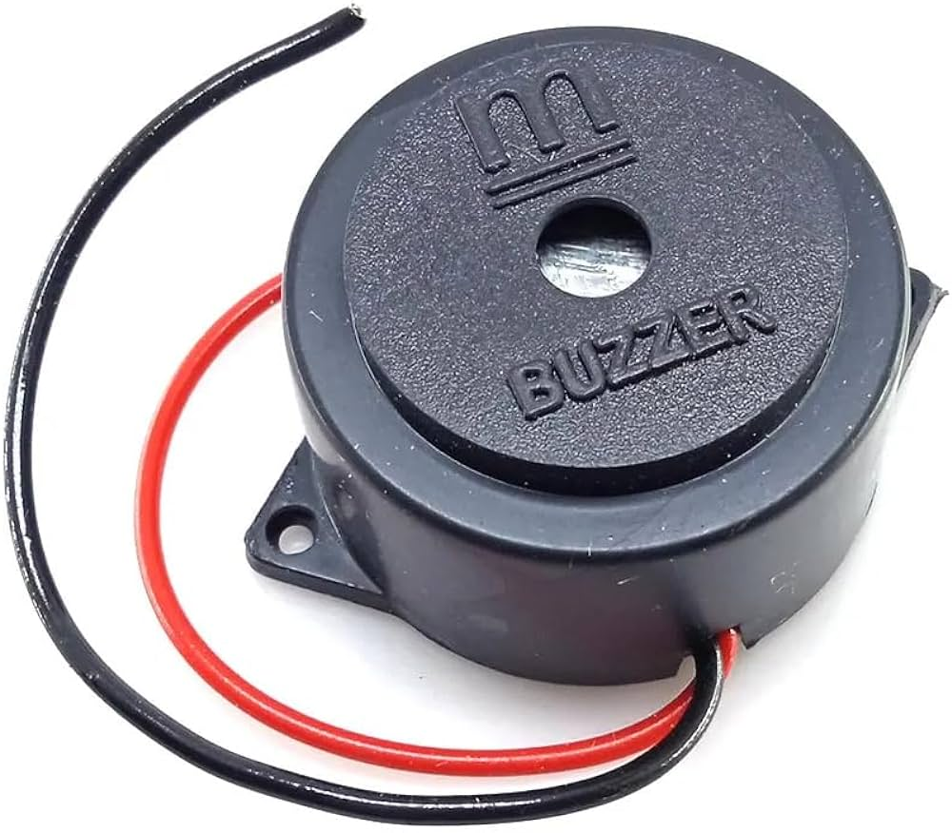
BUZZER
The Small Piezoelectric Buzzer is a compact, versatile audio signaling device commonly used in electronics projects and embedded systems.
It produces sound through the piezoelectric effect, where mechanical vibrations are generated in response to an applied electrical signal, resulting in clear and consistent audio output.

Slide 20
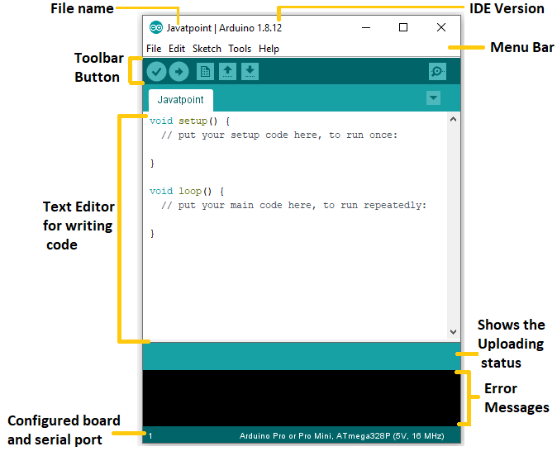
ARDUINO IDE PROGRAMMING SOFTWARE
The Arduino IDE will appear as:
The Arduino IDE (Integrated Development Environment) is an open-source software, which is used to write and upload code to the Arduino boards.
The Arduino Integrated Development Environment - or Arduino Software (IDE) - connects to the Arduino boards to upload programs and communicate with them.
Programs written using Arduino Software (IDE) are called sketches. These sketches are written in the text editor and are saved with the file extension .ino.
Key features include a text editor with syntax highlighting, a serial monitor for debugging, and a library manager for easy access to pre-written code modules.
Arduino IDE supports C and C++ languages.

Slide 21
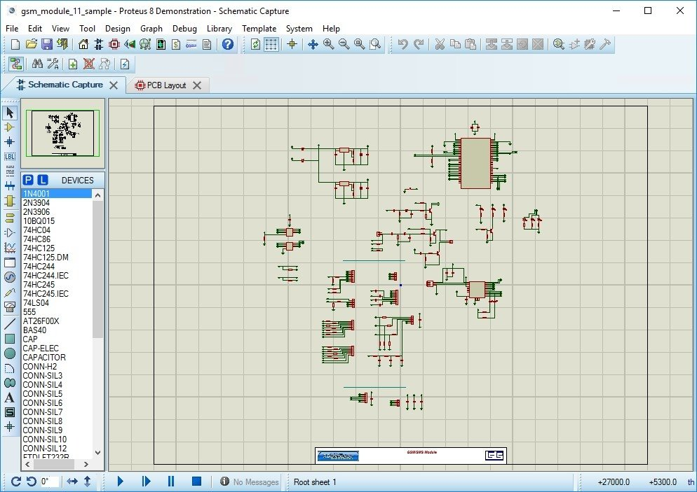
PROTEUS SIMULATION DESIGN SOFTWARE
Proteus Simulation Design Software is a comprehensive tool used for designing and simulating electronic circuits.
Developed by Labcenter Electronics, it combines schematic capture, microcontroller simulation, and PCB design to offer an integrated environment for electronics design.
Proteus supports a wide range of microcontrollers, including those from the ARM, PIC, AVR, and Arduino families, allowing users to create and test both analog and digital circuits.
Its real-time simulation capability enables users to visualize circuit behavior and debug designs before hardware implementation.
The software's intuitive interface and extensive component library simplify the design process.

Slide 22
ADVANTAGE
Provides continuous, automated monitoring without manual intervention.
Allows easy access to data remotely via the ThingSpeak platform.
Offers real-time alerts to notify users of poor air quality.
Cost-effective solution for environmental monitoring compared to traditional systems.

Slide 23
APPLICATIONS
Pollution tracking in urban areas to assess the impact of industrial activity.
Real-time monitoring in factories to ensure safe working conditions.
Integration with city-wide environmental control systems for pollution management.

Slide 24
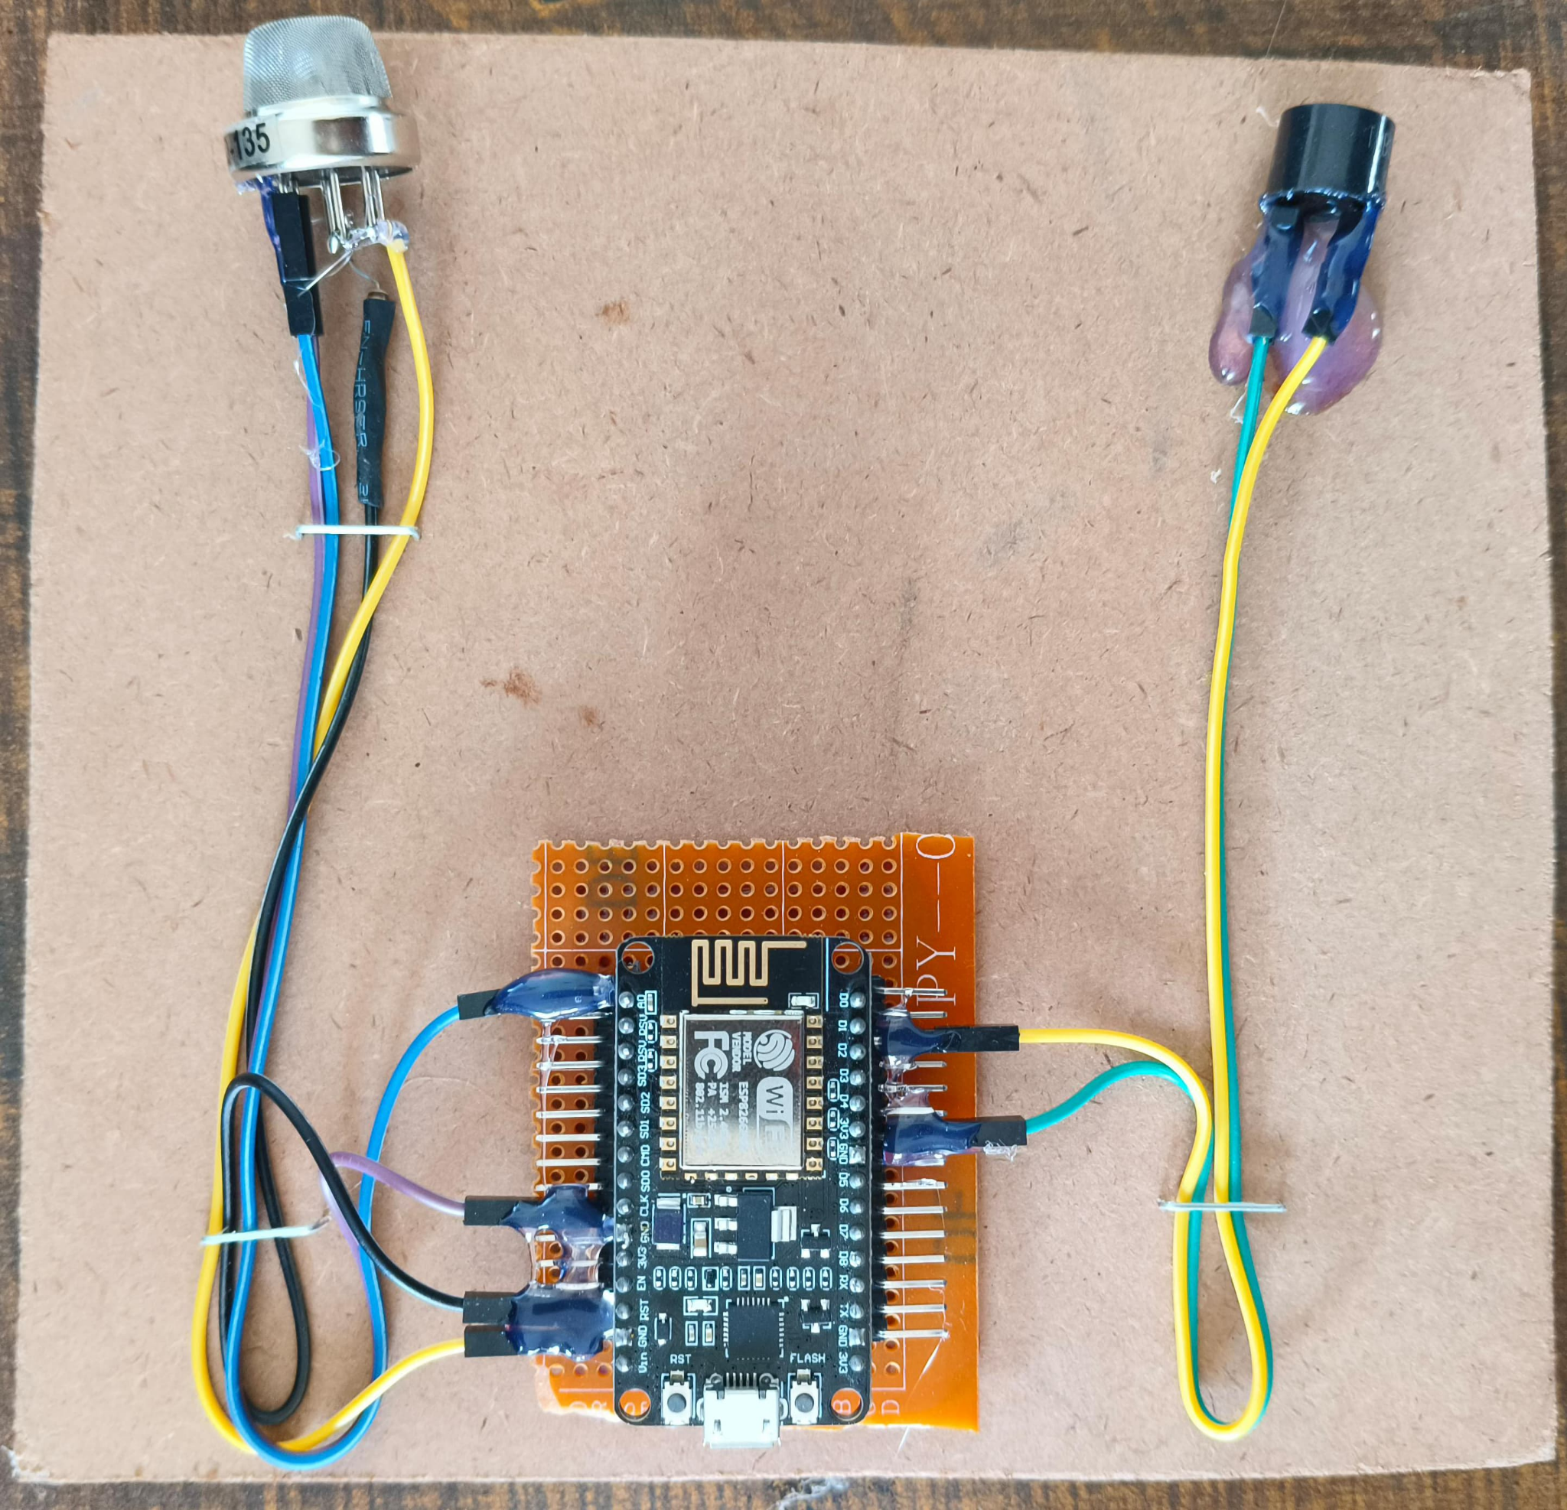
EXPERIMENTAL SETUP
Fig. shows the Experimental Setup of the system

Slide 25
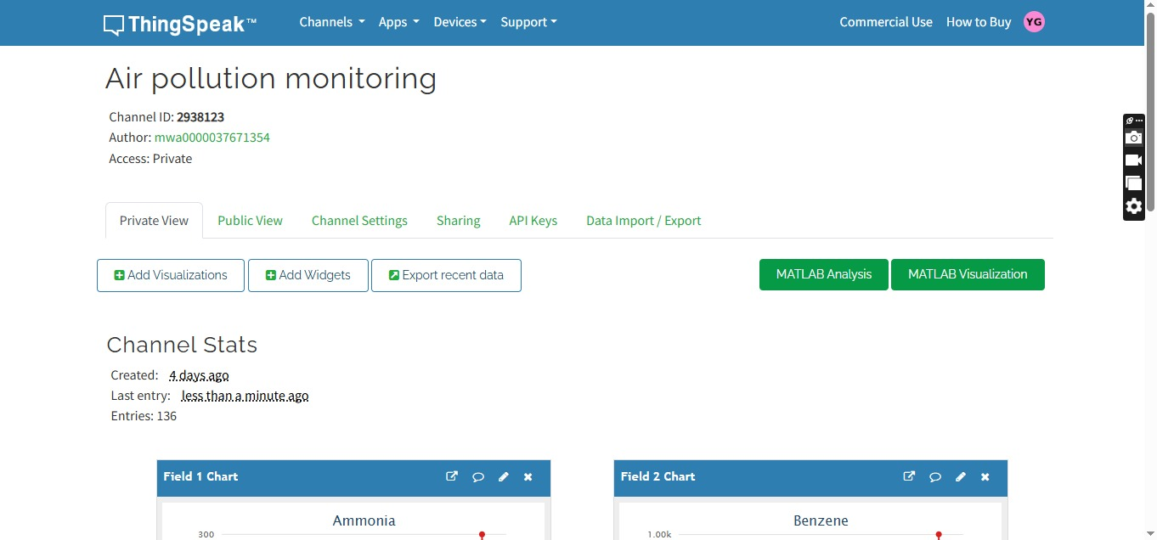
Fig. shows the ThingSpeak channel dashboard

Slide 26
RESULT
The result of the Air Pollution Monitoring System demonstrates successful real-time detection and monitoring of harmful gases in the surrounding environment.
The system accurately displays gas concentration levels in PPM on the ThingSpeak IoT dashboard and generates live graphical trends for each gas over time.
It effectively classifies air quality status as good, moderate, or bad based on predefined thresholds.
When poor air quality is detected, the buzzer is triggered instantly, providing a reliable local alert.

Slide 27
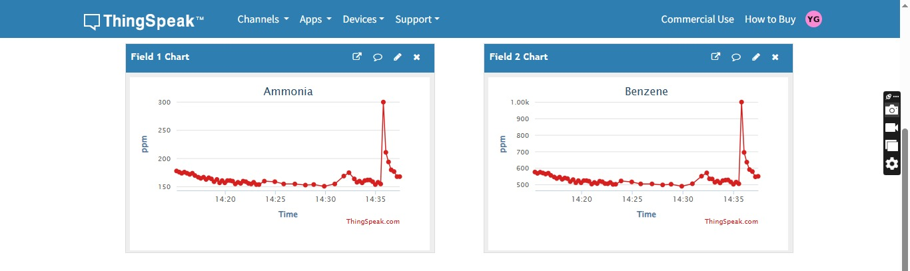
Fig. shows real-time graphs of Ammonia and Benzene gas levels displayed on the ThingSpeak IoT dashboard

Slide 28
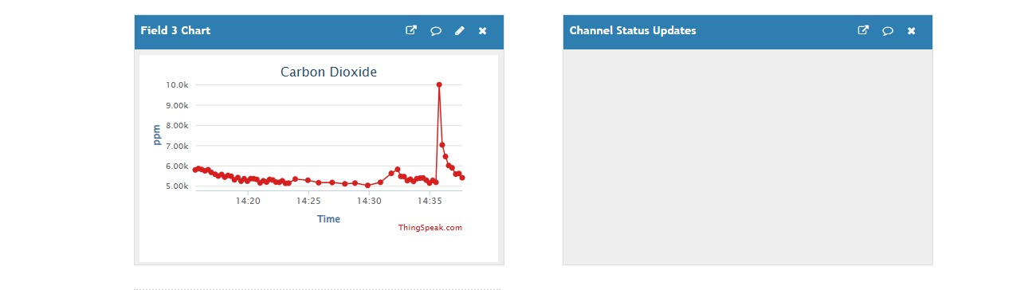
Fig. shows the real-time CO₂ gas concentration plotted and updated continuously on the ThingSpeak dashboard

Slide 29
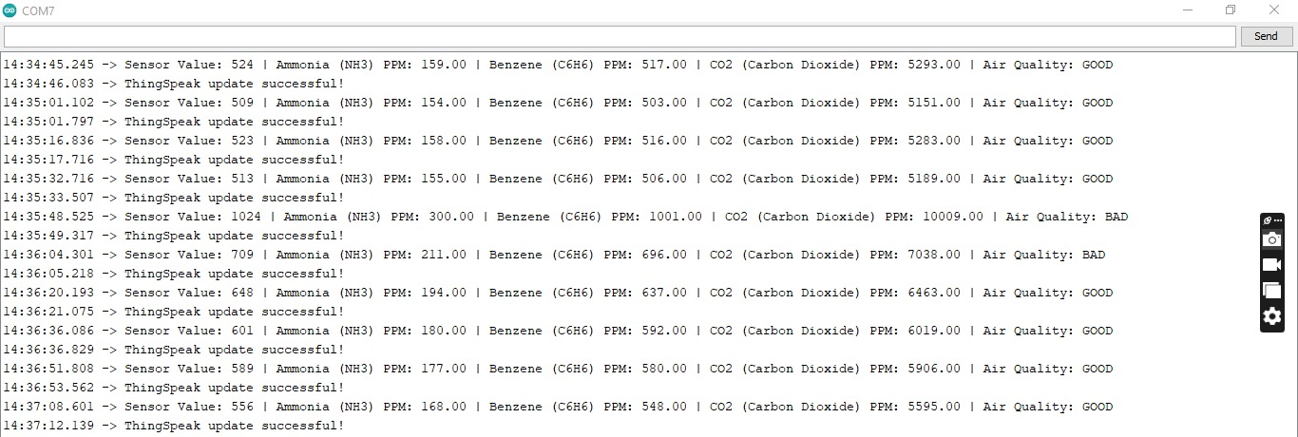
Fig. shows the live serial monitor output displaying real-time readings of Ammonia, Benzene, and Carbon Dioxide along with air quality assessment

Slide 30
CONCLUSION
This project demonstrates the practical application of IoT technology in building a responsive and intelligent air quality monitoring system.
The integration of hardware and cloud platforms showcases how small, low-power devices like the NodeMCU can be used effectively in smart monitoring systems.
It also illustrates how visual data representation and automated responses, such as triggering a buzzer, can support quick decision-making in everyday settings.
The system’s ability to track environmental conditions continuously not only enhances safety but also promotes accountability and environmental consciousness among users.

Slide 31
FUTURE SCOPE
Integration of additional sensors such as PM2.5 and PM10 can allow for more detailed particulate matter analysis.
GPS modules can be incorporated to track pollution levels by location, enabling mobile and location-based monitoring.
The system can be connected to a mobile application for real-time alerts, data access, and health recommendations based on individual exposure.
Machine learning algorithms could also be used to predict pollution trends and identify sources based on historical data.

Slide 32
REFERENCES
[1] Parmar, Gagan, Sagar Lakhani, and Manju K. Chattopadhyay. "An IoT based low cost air pollution monitoring system." In 2020 International Conference on Recent Innovations in Signal processing and Embedded Systems (RISE), pp. 524-528. IEEE, 2020.
[2] Malleswari, S. M. S. D., and T. Krishna Mohana. "Air pollution monitoring system using IoT devices." Materials Today: Proceedings 51 (2022): 1147-1150.
[3] Pal, Poonam, Ritik Gupta, Sanjana Tiwari, and Ashutosh Sharma. "IoT based air pollution monitoring system using Arduino." International Research Journal of Engineering and Technology (IRJET) 4, no. 10 (2023): 1137-1140.
[4] Dhingra, Swati, Rajasekhara Babu Madda, Amir H. Gandomi, Rizwan Patan, and Mahmoud Daneshmand. "Internet of Things mobile–air pollution monitoring system (IoT-Mobair)." IEEE Internet of Things Journal 6, no. 3 (2019): 5577-5584.
[5] Xiaojun, Chen, Liu Xianpeng, and Xu Peng. "IOT-based air pollution monitoring and forecasting system." In 2023 international conference on computer and computational sciences (ICCCS), pp. 257-260. IEEE, 2023.

Slide 33
THANK YOU !

